Slide 1
How to Port WIFI Forwarding Function
2016/06/24

Slide 2
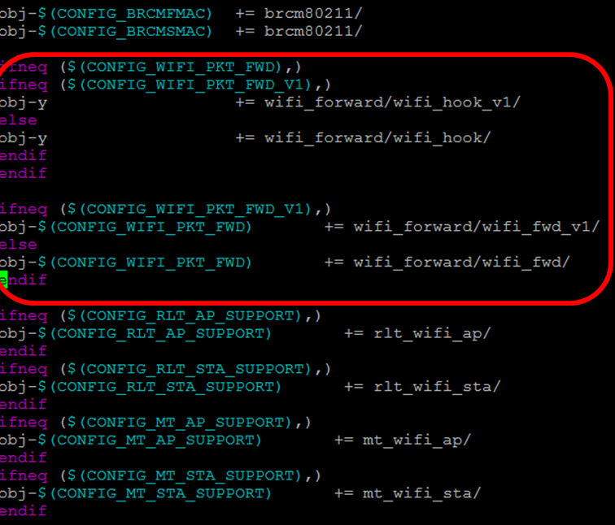
How to Port Forwarding Function
Copy wifi_forward and mt_wifi to linux-3.10.14.x/drivers/net/wireless/
Add below red zone part to source/linux-3.10.14.x/drivers/net/wireless/Makefile)
Reference MakeFile

Slide 3
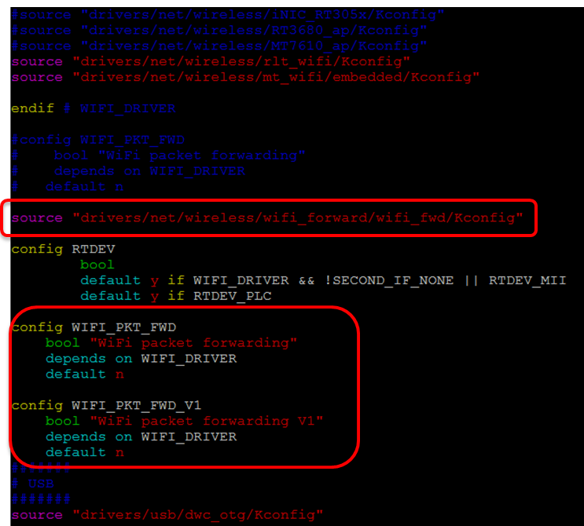
How to Port Forwarding Function
Add below red zone part to source/linux-3.10.14.x/ralink/Kconfig)
Reference Kconfig

Slide 4
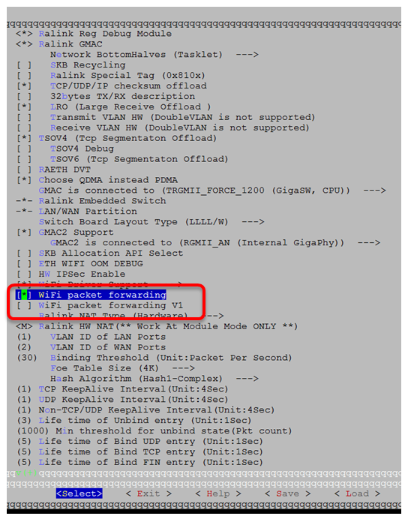
How to Port Forwarding Function
Driver Version:MT7615 V4.4.1.0 and newer version
Enable [*] WiFi packet forwarding in kernel option.
<Note>Don’t select WiFi packet forwarding V1
cd to source
make dep
make

Slide 5
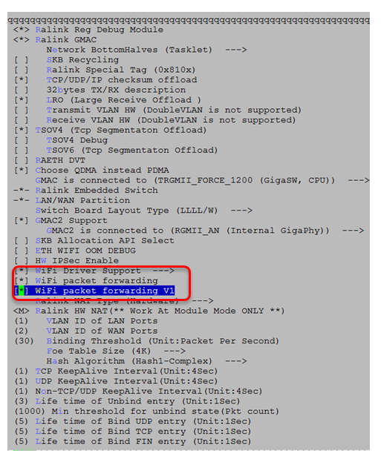
How to Port Forwarding Function
Driver Version:MT7615 V4.4.0.2 (MPv2.0)
Enable [*] WiFi packet forwarding and WiFi packet forwarding V1 in kernel option.
cd to source
make dep
make

